Slide 1
Disability Wisdom & the Jewish Collective:
Inclusion as a Jewish Imperative
Arielle Silverman, Disability Wisdom Consulting
Lisa Handelman, Jewish Federation of Greater Washington (DC)
Notes:
Introduce ourselves - Arielle, then Lisa

Slide 2
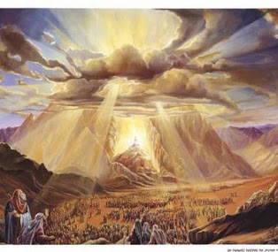
Our tradition teaches - When the Torah was given, ALL Jews were standing at Sinai.
Disability Wisdom – the wisdom required for all to stand together
As individuals, with and without disabilities – how close are we to achieving this?
What are the stages or steps necessary to advance disability inclusion?
How can inclusion be viewed as a Jewish Imperative?
Notes:
Arielle introduces the concept of Disability Wisdom and that to illustrate how we can achieve this ideal, we are going to spend sometime exploring 5 stages that move us from antipathy and active exclusion towards becoming wise and truly inclusive.
Lisa introduces Jewish Framing - As if we were all at Sinai
There is a midrash often sited around the holiday of Shavuot, that teaches that all Jewish, past, present and future received the Torah collectively at Mt. Sinai. The midrash teaches that God gave us all the Torah simultaneously, in a way each of us could understand. No one was excluded due to perceived disabilities. We are all created in the image of God, we are all equally able to receive the Torah.
A painting of the ancient Israelites gathering at the foot of Mount Sinai. Light is coming from the clouds as if God is speaking to everyone.

Slide 3
Stage 1 :Antipathy and Active Exclusion
The Jewish Community
M’shaneh Habriyote
בָּרוּךְ אַתָּה יהוה אֱלהֵינוּ מֶלֶך הָעולָם משנה הבריות
Blessed are You, LORD, our God, King of the Universe, who makes creatures different.
Baruch ata Adonai, Eloheinu melech ha-olam, m’shaneh habriyote.
Blemishes, Imperfections, Disabilities
A blemished priest was not permitted to serve and could not approach the altar. A blemished animal could not be used for a sacrifice (Leviticus)
Negative imagery of disability
Israel's watchmen are blind, they all lack knowledge; they are all mute dogs, they cannot bark; they lie around and dream, they love to sleep (Isaiah 56:10)
Barriers continue
RespectAbility 2018 Jewish Disability Inclusion Survey found “prejudice and unacknowledged stigma against people with disabilities” to be the biggest barrier https://www.respectability.org/2018/09/jewish-disability-inclusion-survey/
Notes:
Antipathy is a voluntary or involuntary dislike for something or somebody. There were and are communities where disabilities are hidden out of embarrassment/shame and as Judy Heumann recently said – how many of us would welcome…
M’shaneh Haberiyot - Jewish law prescribes the recitation of a blessing upon seeing an unusual person or animal. According to Jewish legal codes, this includes an albino, a dwarf, an extremely tall person, a monkey, and an elephant.
Blemishes, imperfections were seen negatively (https://www.jewishvirtuallibrary.org/blemish )
Frequently, biblical prophets use negative imagery of disability when delivering their message. (https://www.sbl-site.org/assets/pdfs/TBv2i8_SchipperDisability.pdf )
The recent “RespectAbility 2018 Jewish Disability Inclusion Survey,” which focused on the inclusion of people with disabilities in faith communities in America, found that - More than a third of Jewish respondents with a disability identify the biggest barrier as “prejudice and unacknowledged stigma against people with disabilities.” https://www.respectability.org/2018/09/jewish-disability-inclusion-survey/
While there are scholars who modernize these teaching and reclaim them in more positive light, if we want to advance disability inclusion it is important to recognize when something is problematic.
Recognizing that prejudice and unacknowledged stigma are a major barrier to inclusion, requires us as a community to examine antipathy, not ignore what was problematic in the past or ignore continued problems

Slide 4
Stage 1: Recognizing Our Emotional Blocks
Our Individual Journey
Disgust, fear of contagion.
Fear of becoming disabled.
Contempt toward people seen as “free-riding.”
Anxiety about someone who looks, sounds or acts different.
For the disabled person, Stage 1 may be characterized by a strong sense of self-loathing, as the individual may view their disability as a blemish on their own character

Slide 5
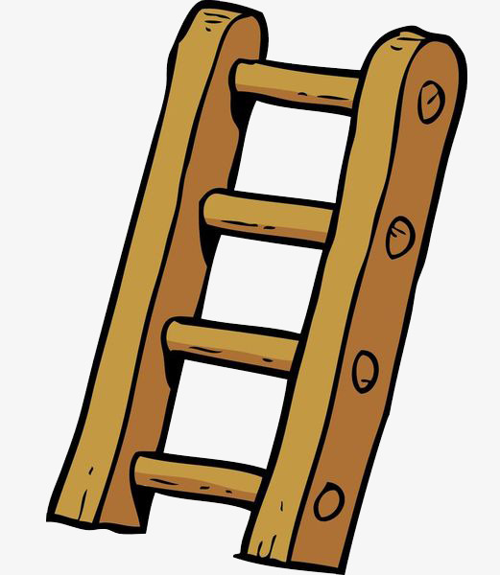
Stage 2: Tolerance or Passive Exclusion
The Jewish Community
84% of People with Disabilities say their faith is important to them, but only 45% of people with severe disabilities attend a place of worship at least monthly.
Data collected by the Collaborative on Faith and disabilities
http://faithanddisability.org/
Statements commonly heard from congregational leaders:
  “We don’t have anyone with THOSE kinds of disabilities”
  “We know our congregants, and we are providing for all their needs”
  “We already have a very welcoming culture; we take care of everyone’s needs”
  “We try, but we don’t have the resources to accommodate everyone’s needs”
eJewish Philanthropy article
How Inclusive Are You of Those with-disabilities by Ed Firm
February 2018
Sulam Hakh’lala
A Ladder of Inclusion
in Keeping with Jewish Values
Bottom rung:
Sheirut – Gmilut Hasadim
Service and Acts of Loving Kindness
Providing service to others with disabilities outside our congregations in their own spaces and lives
Delivering and serving a Shabbat dinner, collecting materials, raising funds
Notes:
Data shows we that passive inclusion is prevalent:
the Collaborative on Faith and Disability 84% of People with Disabilities say their faith is important to them,; 45% of people with severe disabilities attend a place of worship at least monthly; only 10% of faith communities do congregational-wide disability awareness
Ed Frim, Director of Learning Enrichment at United Synagogue of Conservative Judaism and USCJ’s Inclusion Specialist until July 2017, wrote an eJewish Philanthropy article in February 2018 where he talked about creating A Ladder of Inclusion in Keeping with Jewish Values Sulam (ladder), Hakhlala (inclusion)
https://ejewishphilanthropy.com/how-inclusive-are-you-of-those-with-disabilities/
Noted what he commonly hears from congregational leaders
Created a “ladder of inclusion” (structured similar to Maimonides ladder of giving Tzedakah (from unwillingly to providing support so no longer dependent on support)
First rung – Providing services and programs to individuals with disabilities
giving willingly but outside the congregation (Maimonides second rung)
When we say “we don’t have anyone with disabilities here”, when we don’t challenge our congregational schools and youth directors to ask “where are children”, we are practicing tolerance and passive exclusion.

Slide 6
Stage 2: Tolerance or Passive Exclusion Our Individual Journey
Most people without a disability contact start out at this stage.
For the disabled person, Stage 2 may mark an attitude of minimization, where the individual might conceal their disability (if they can) and generally distance themselves from disability communities.

Slide 7
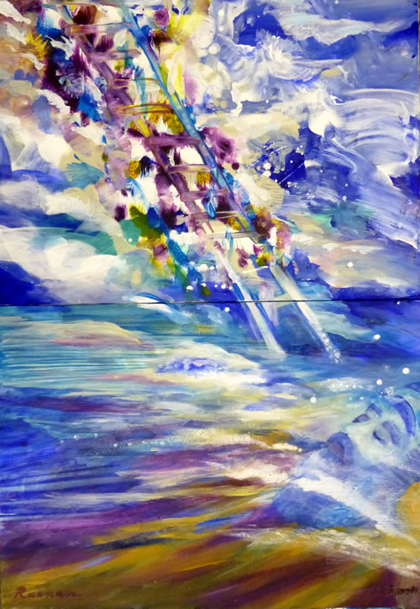
Stage 3: Helping and Inspiration
The Jewish Community
In Genesis, Jacob dreams about a ladder with God’s angels going “up and down”(28:17)
Hafrada
Providing services and programs to individuals with disabilities within separate programs.
Specifically designed disability programs; a program for not necessary with individuals with disabilities
A Purim party for residents of group homes, a separate youth group chapter
Hachnasat orchim
Welcoming “others” - beginning the process of relationship building
Annual JDAIM programs that invites residents of group homes or Deaf individuals to services
A special disability advocate speaker to share an inspiring story
Notes:
As a community, we seem to go up and down on this ladder of inclusion. Maybe this “up and down” in and of itself, is part of the process; we need to understand and value of all the rungs on the ladder In stage 3, we climbing two more rungs on the Ladder of Inclusion
Mitzvah projects that provide service to others with disabilities outside our congregations may be for some congregations a necessary first step/rung
Separate programs have a value
Aaron and his choice of Birthright program
WSJD request for support to have their own Jewish programing
Relationship building – is key
Maybe we need to first welcome “others” before we can learn the disability wisdom principal of treating a person with a disability as an “ordinary other”.
JFGH Shabbaton and Capital Camps – an example of relationship building
small paining of angels going up and down a ladder in the sky to represent the ladder Jacob dreams about with God’s angels going up and down.

Slide 8
Stage 3: Helping and Inspiration
Our Individual Journey
People in Stage 3 include disabled people, but mainly out of a sense of pity, obligation, or a desire to help.
People in Stage 3 may also be big consumers or producers of ”inspiration porn.”
For a disabled person, meanwhile, Stage 3 might involve behaviors of overcoming or overcompensating for disability, still striving to distance oneself from disability and the associated community.

Slide 9
Stage 4: Individual Equality
The Jewish Community
“Teach each child according to their way” (Proverbs)
“How pleasant it is when brother and sister dwell together” (Psalms)
Bruchim haba’im
Welcoming and Integrating
Individuals with disabilities are welcomed and encouraged to participate to the best of their abilities.
All are welcome
Hitnadvut
Volunteering/Participating
Supports are provided so that all can participate.
Accommodations provided; funding may be “as needed” and/or the responsibility of individuals with disabilities
Notes:
How pleasant it is when brother and sister dwell together… (those we know)
Teach each child based on their way (our children, those close to us)
Next rungs are build on relationship
Bruchim habaim - Welcoming and Integrating – “blessed are all who come” individuals with disabilities are welcomed and encouraged to participate to the best of their abilities. – we want those we have relationships to be part of our community
Hitnadvut - Participating – supports are provided so that individuals can participate. We advocate, demand, provide accommodations so these individuals, our brothers, sisters and children can participate.

Slide 10
Stage 4: Individual Equality
Our Individual Journey
There is a growing understanding that people with disabilities are all around us and that their presence builds a stronger community for all.
People at Stage 4 may not yet recognize the value of cross-disability activism or universal design. They may be willing to make accommodations for individual disabled people in their lives, but may not anticipate the need to make environments accessible for other disabled people who might come in the future.
Disabled people at Stage 4, meanwhile, will advocate for their own needs and demand equal access for themselves, but they may not get involved in broader activism.

Slide 11
Stage 5: Inclusion as Social Justice
The Jewish Community
Hevruta - Partnership
  Supports are provided in a free and seamless way so that all can participate as equal partners. The concepts of universal design and universal design of learning are incorporated so that all have access
Terumah- Contributing
  Everyone’s voice is heard by recognizing and acknowledging each individual and their potential to contribute in meaningful ways.
Manhigute - Leadership
  Opportunity for leadership within all aspects of congregational life.
Hakh’lala- Inclusion
  A culture based on the rights of each person to participate
Notes:
My experience – as a Jewish community we find ourselves on many different rungs of the ladder of inclusion.
These final four rungs, help us move inclusion from being about a benefit to an individual toward an understanding and paradigm shift towards seeing inclusion as a fundamental right that strengths our community
Hevruta, Partnership - free and seamless supports, participation as equal partners. The concepts of universal design and universal design of learning benefits all (curb cuts, differential instruction)
Terumah, Contributing – everyone’s voice is heard each individual has potential and can contribute in meaningful ways. (Diversity benefits the collective; eliminating racism, sexism, ableism benefits all)
Manhigut, Opportunity for leadership; if we are really listening to everyone’s voice, who are our leaders will shift, if we don’t have individuals with disabilities as leaders without our congregations, we still have work to do.
Hakhlala, creating a culture based on the rights of each person -Tzedek (justice) not chesed (charity) a community that truly believes we are all created in the image of God

Slide 12
Stage 5: Becoming Wise
Disabled people at Stage 5, meanwhile, will engage in collective activism even if the particular issue may not impact them personally, if it impacts other members of the disability community.
“Nothing about us without us.”
Disabled people are deserving of dignity, humanity and ordinary treatment.
Acknowledge full humanity: treating the person with dignity and respect, as an equal.
Principle of the “ordinary other”: Disabled people have the same range of interests, strengths, and preferences as nondisabled people.

Slide 13
Conclusion
“The Jews’ greatest contribution to history is dissatisfaction! … whatever exists we believe we can do better” – Shimon Peres
We need to continue to investigate the factors that might guide this process; exposure, education, relationship building
We need to recognizing that not every community or individual needs to pass through each stage, and time in each stage can vary for individuals and for communities.
As advocates, we need to adjust our approach based on the stage a particular community or individual has achieved.
A customized approach is likely to make the most impact.
Let’s move forward with the belief that we were all standing at Mt Sinai, that we are all creating in the image of God.
Notes:
I have this Shimon Peres (former President of Israel) quote on my desk at work “The Jews’ greatest contribution to history is dissatisfaction!
We are not at the end of journey to be fully inclusive – we need to be more dissatisfied, we need to challenge apathy and passive exclusion; we need to be dissatisfied that while we may accommodate some, we don’t yet accommodate all.
Accommodating can be hard – how do we simultaneously accommodate those who need dim light with those that need bright light, those that pray silently with those that vocalize…
I think Jewish teaching, like the steps on the ladder of inclusion, can help us on this journey – wrestling with these issues like Jacob wrestled with an angel (God), can lead us to become a better community. (Genesis 32:22-31)

